Slide 1
Laptop Price Analysis Dashboard

Slide 2
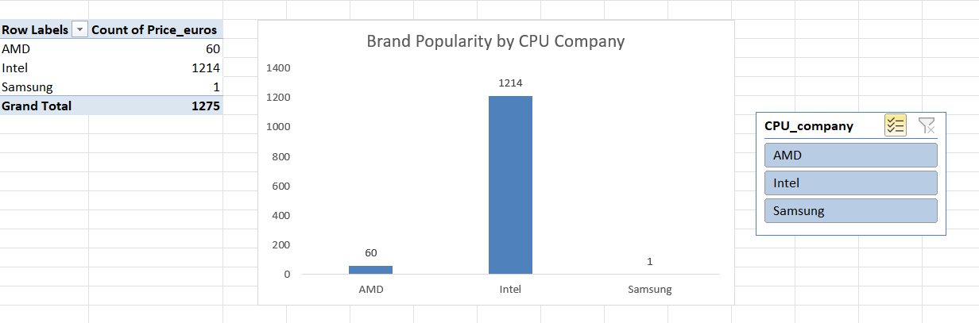
Brand Popularity by CPU Company

Slide 3
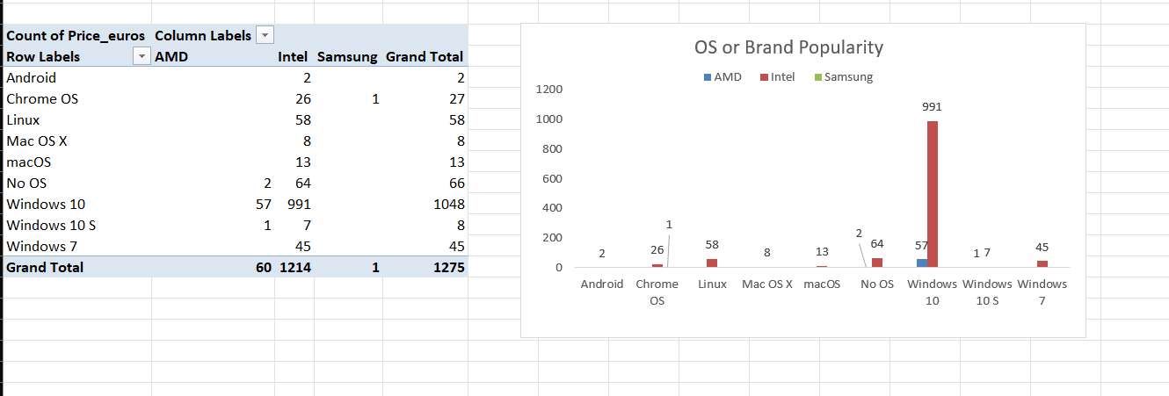
OS or Brand Popularity

Slide 4
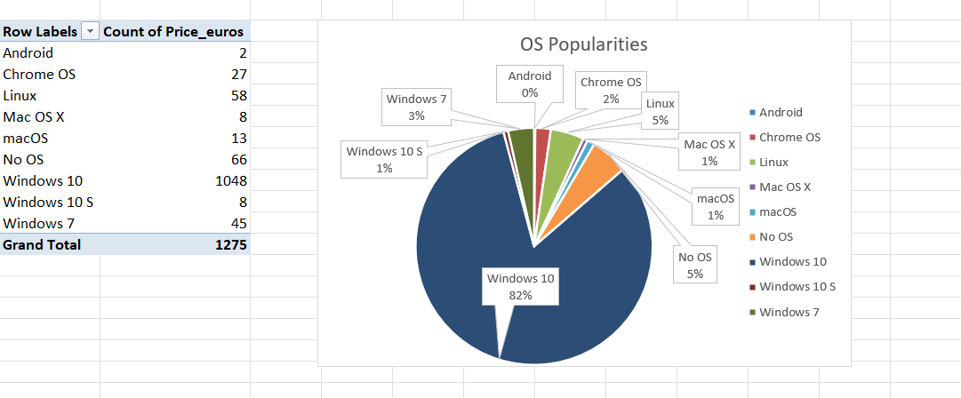
OS Popularity

Slide 5
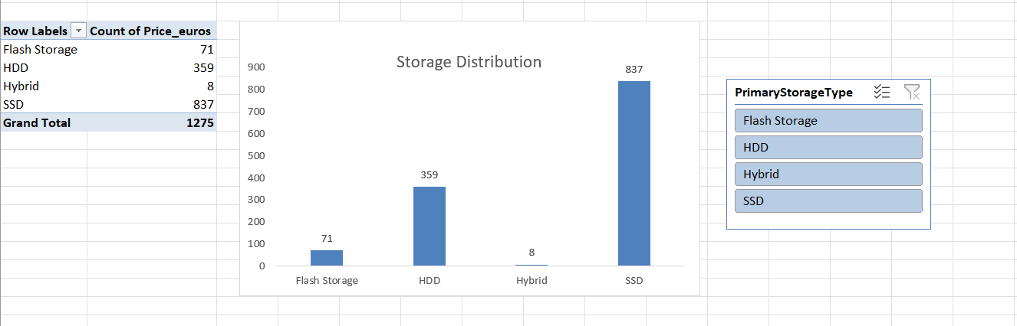
Storage Distribution

Slide 6
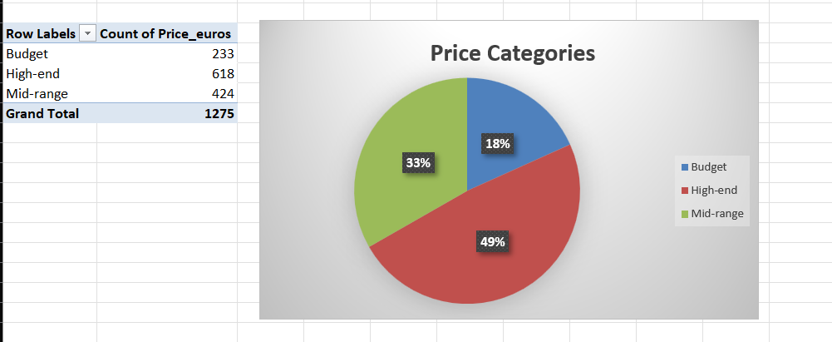
Price Categories

Slide 7
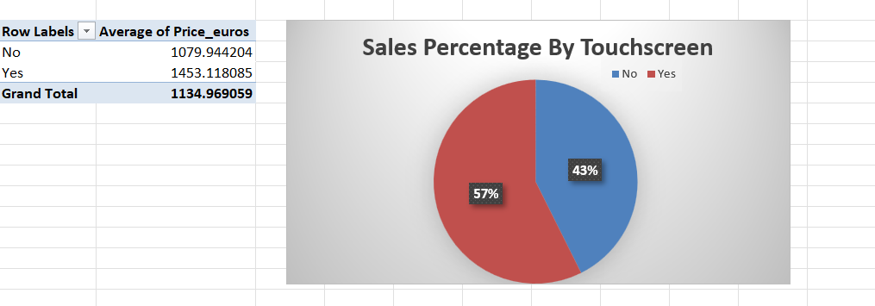
Sales Percentage By Touchscreen

Slide 8
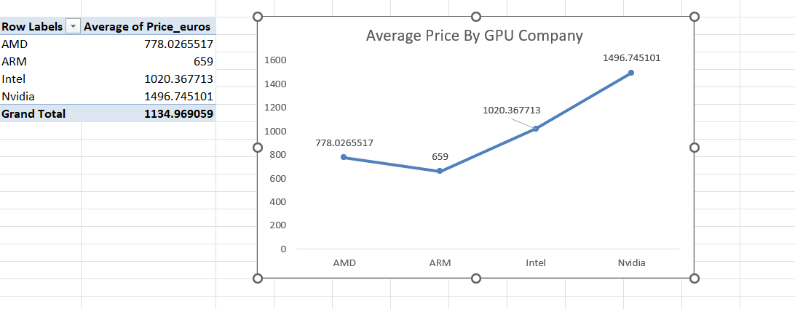
Average Price By GPU Company

Slide 9
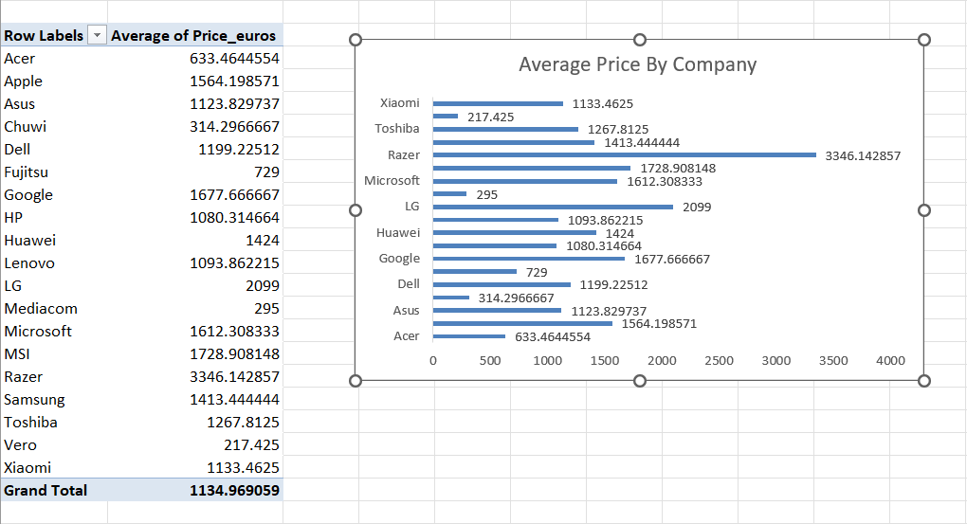
Average Price By Company

Slide 10
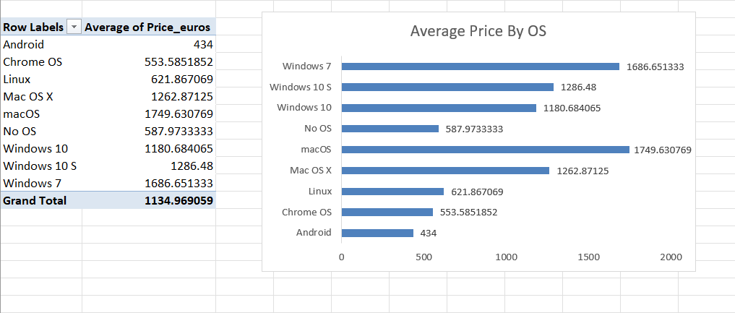
Average Price By OS

Slide 11
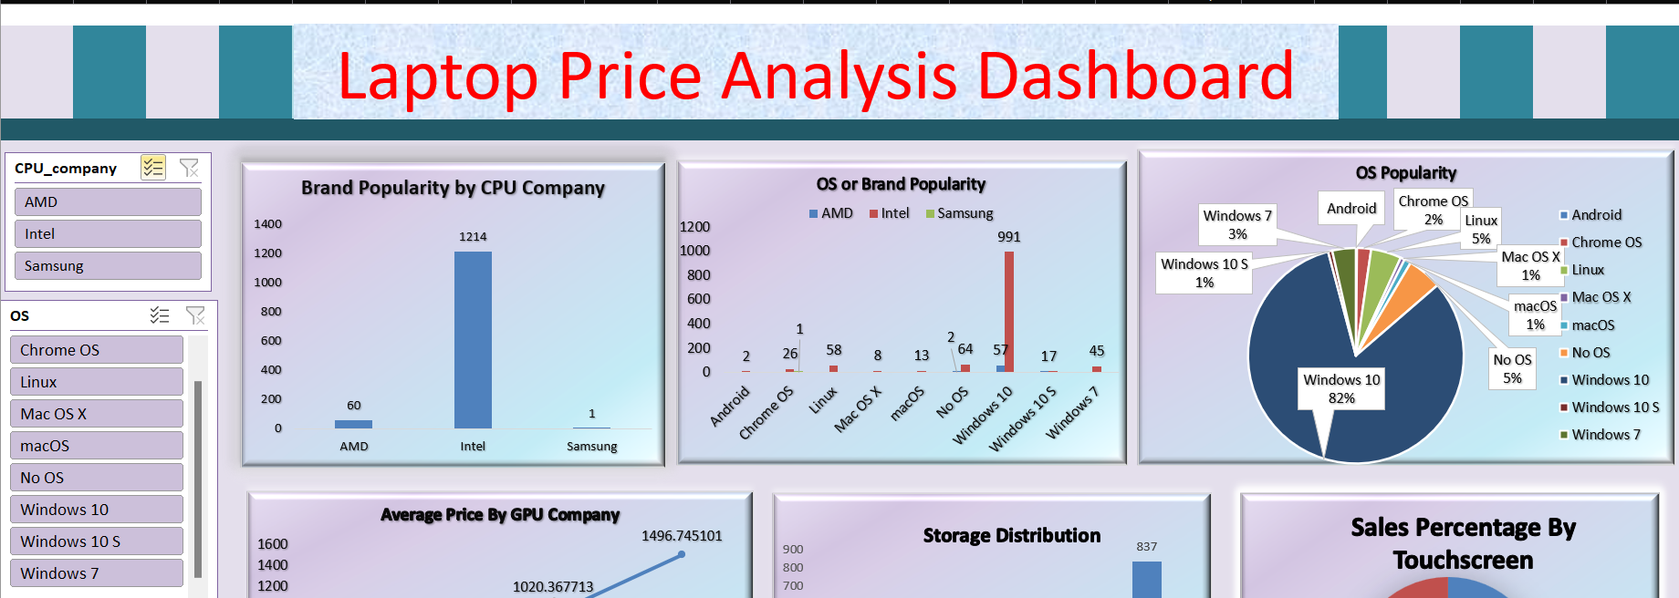
Laptop Price Analysis Dashboard

Slide 12
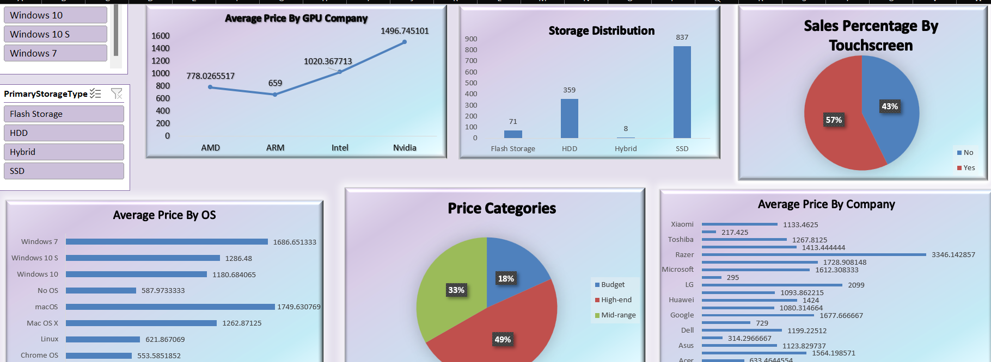

Slide 13
Insights
1. macOS/Windows 7 laptops are premium-priced.
2. Intel/Nvidia: High-end processors, AMD: Competitive pricing.
3. SSDs dominate storage, with touchscreens adding 34.5% price premium.
4. Market share: Mid-range (53%), Budget (29%), High-end (18%).
5. Premium brands: Razer, LG, Apple; Budget brands: Chuwi, Mediacom.

Slide 14
Recommendation
1. OS and Processor Market Share Charts
2. Price Range Filters ($500-$2000) and Price Trend Line Charts
3. Laptop Specifications and Feature Comparison Tables
4. Storage Type and Touchscreen Adoption Pie Charts
5. Brand Price Comparison Bar Charts and Average Price Pie Charts

Slide 15
THANK YOU

